Slide 1
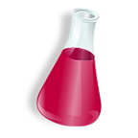
States of matter
Solid, liquid, gas

Slide 2
SOLIDS
STATE | SHAPE | VOLUME | PARTICLE SPEED
GAS | OF CONTAINER | OF CONTAINER | FASTEST
LIQUID | OF CONTAINER | DEFINITE | MEDIUM
SOLID | DEFINITE | DEFINITE | SLOWEST

